Slide 1
Getting Familiar with Databases
Winnie Cai Serge Mavuba
Dana Hausman Corinne Haley
Notes:
Hello All, thank you for joining us today as we attempt to help you get more familiar with databases. We are team 4 and our presenters today will be myself, Corinne, Serge, Dana and Winnie.

Slide 2
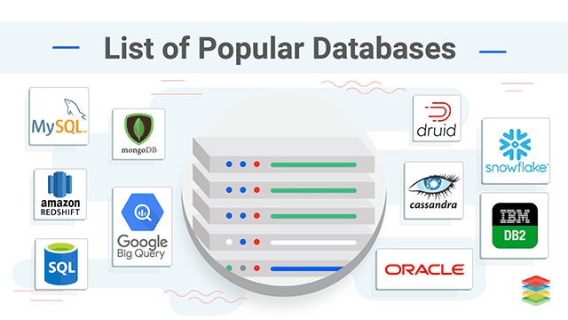
Notes:
Corinne
Though there are many types of databases, today we’re going to specifically define relational and non-relational databases and provide you with a demonstration on how to use a relational database.

Slide 3

How do you define a Database?
A database is a collection of bits of data that is organized into files, which are called tables. Tables are a logical way of accessing, managing, and updating data.
In a database, data can also appear in other formats, such as figures, graphics, images, and audio-video recordings.
Database Types:
Relational databases
Non-relational databases
Notes:
Corinne
So, let’s begin with defining a database.
Simply put, a database is a collection of bits of data that is organized into files, which are called tables.
Once stored, this data can be easily accessed, managed, modified, updated, and organized.
Databases exist on the backend, or behind most data-driven applications, data-driven websites, and data-driven mobile apps.

Slide 4

What’s the difference?
Notes:
Corinne
So, what’s the difference between relational and non-relational databases?

Slide 5
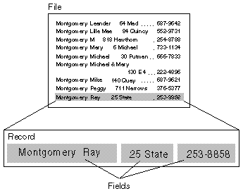
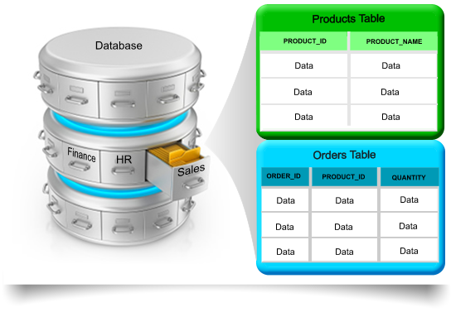
Relational (SQL)
Structured query language
Rigid schema
Run transactional or analytical queries
Used primarily in relational databases
Easily update, delete, or add to existing DBs
Uses vertical scaling, which means changing the resources (CPU,RAM), inside the computer or virtual machine (WM) to fit the needs of the database
Use cases
Traditional application, enterprise resource planning (ERP), customer relationship management (CRM), ecommerce
Notes:
Corinne
A relational database, which is often referred to as a SQL database, stores and provides access to data points that are related to one another. Databases based on the relational model, are an intuitive, straightforward way of representing data in tables.

Slide 6
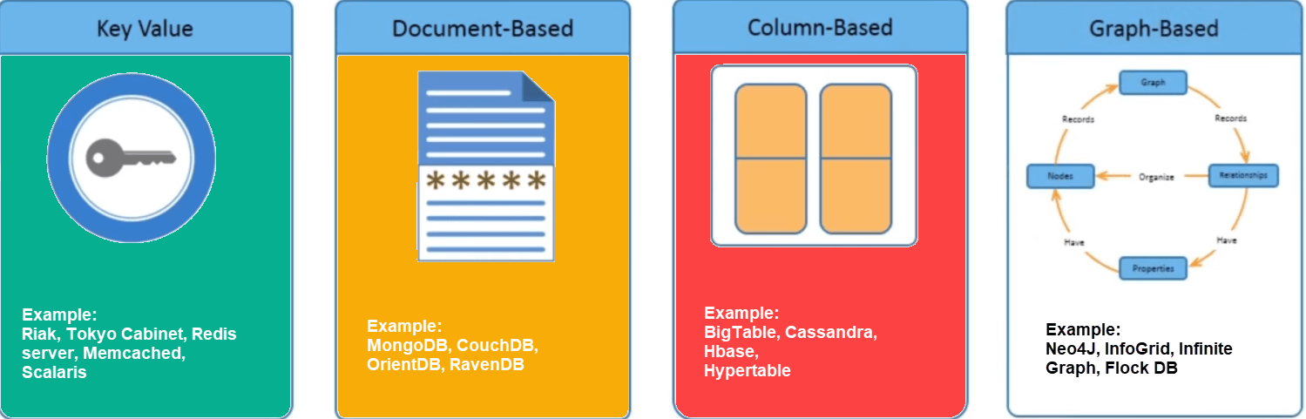
Non-relational (NoSQL)
Not only SQL
Not a rigid schema
Uses different types of data models, such as graph, document, key-value
Alternative to traditional relational DB
Used for large data stores in cloud and web applications
Uses horizontal scaling, which means adding more computers, servers, and more
Use cases
High traffic web applications, ecommerce systems, gaming applications
Notes:
Corinne
NoSQL databases don’t use a table structure to store data.
They use various data models for accessing and managing data and are optimized specifically for applications that require large data volumes, low latency, and flexible data models.
The requirements are achieved by relaxing some of the restrictions around data consistency that are used by other databases.
NoSQL databases are built for specific data models. The have flexible schema, or structures, for building modern applications. This just means that the columns don't have to be consistent across records, and you can add a column to specific rows without having to add them to every single record.

Slide 7
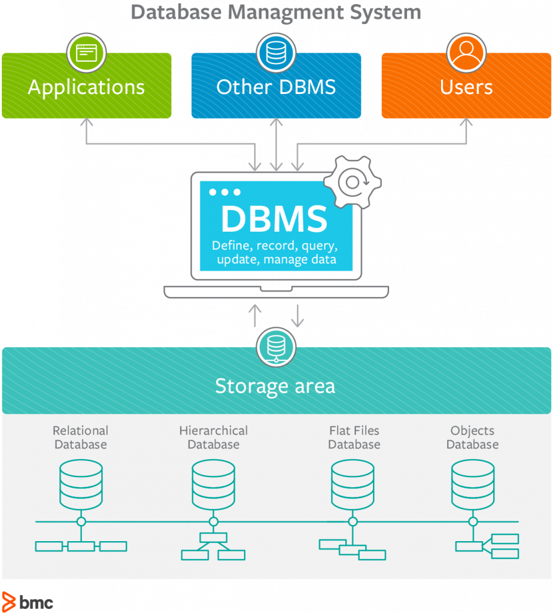
Database Management System (DBMS)
You manage stored data with a database management system (DBMS).
Notes:
Corinne
A database is usually controlled by a database management system (DBMS).
A database management system (DBMS) is software or database-as-a-service (DBaaS).
This is the go between for storing, retrieving, updating, or deleting data in the database.
Now that you know the basic definitions and uses for DBs, I’ll turn you over to Serge who will begin speaking on how to create and management.

Slide 8
Managing Databases
Create database Sample
The CREATE DATABASE statement
Sample - usersDB;
Rename a database:
The ALTER statement
ALTER DATABASE Sample MODIFY name = usersDB
Delete or dropping:
The DROP DATABASE statement
DROP DATABASE SampleDB
Drop database Sample1
Notes:
Serge
Flip screen
Can not drop a database when it is in use currently

Slide 9
Managing Tables
Create table tblEmployee
The CREATE TABLE statement is used to create a new table in a database.
CREATE TABLE tblEMployee (
EmployeeID int not null Primary Key,
Fname nvarchar (50) not null,
Name nvarchar (50) not null,
GenderID int
);
Notes:
Serge
Flip screen

Slide 10
Managing Tables(cont’d)
The ALTER TABLE statement is used to add, delete, or modify tables.
Rename a table:
ALTER TABLE tblStudent RENAME TO tblGraduate
Change the column within a table:
ALTER TABLE Modify Column
ALTER TABLE tblStudent a add Email nvarchar(100);
Alter table tblStudent:
To delete a column in the table tblStudent, use the following syntax:
ALTER TABLE tblStudent DROP Email;
Notes:
Serge
Flip screen

Slide 11
Order of Execution
1. FROM tblLearner
2. ON tblLearner.genderID = tblGender.ID
3. JOIN inner/left/right
4. WHERE jobTitle = ‘cloud engineer’
5. GROUP BY group by States
6. WITH CUBE OR WITH ROLLUP group by rollup (States)
7. HAVING sum(salary) > 100000
8. SELECT ID, Fname, Lname or *
9. DISTINCT unique records with one column or combined column
10. ORDER BY Fname desc
11. TOP top 5, 10, or by %
Notes:
Serge
Rollup is used to do aggregate operation on multiple levels in a hierarchy

Slide 12
Data Integrity
What does the term data integrity mean?
The term data integrity refers to the correctness and completeness of the data in a database. To preserve the consistency and correctness of its data, a RDBMS imposes constraints.
TYPES OF DATA INTEGRITY
Required data
Entity integrity
Foreign key
Validity checking
Consistency
Referential integrity
Business rules
EXAMPLES:
not allowed to have missing data or NULL
primary key must contain unique value in each row
has to be one of the value contained in the table it points to
set of values permitted for column
updates to one table can corresponding change in linked tables
primary key in parent table links to foreign key in child table
quantity in a column must be above a set amount
Notes:
Corinne
No flip screen
Data integrity is the maintenance, and the assurance of data accuracy and consistency over its entire life-cycle and is a critical aspect to the design, implementation, and usage of any system that stores, processes, or retrieves data.
When the contents of a database are modified with the insert, delete or update statements, the integrity of the stored data can be lost in many ways.
To preserve the consistency of its data, a RDBMS imposes one or more data integrity constraints.
One type of constraint is the foreign constraint. Foreign keys are used to enforce database integrity. In layman’s terms, a foreign key in one table points to a primary key in another tables. The foreign key constraint prevents invalid data form being inserted into the foreign key column. The values that you enter into the foreign key column has to be one of the values contained in the table it points to.

Slide 13
Example:
Foreign constraint
ALTER TABLE tblPerson ADD CONSTRAINT FK_tblPerson_genderID
Foreign key (genderID) references tblGender(ID)
Default constraint
ALTER TABLE tblPerson ADD CONSTRAINT DF_tblPerson_GenderID DEFAULT 3 FOR genderID
Notes:
Corinne
In this first example we are altering the table name tblperson by adding the constraint name foreign key to the tblperson gender ID column. This means that if the value in the column genderID is empty, this will show as an invalid entry.
In the second example we are altering the table name tblperson by adding the constraint name default value 3 to the tblperson gender ID column.

Slide 14
SQL SELECT with Order By, Insert, Update and Delete Command
SQL INSERT statement is used to add rows to a table. Insert can be used in several ways:
To insert a single complete row, OR insert a single partial row
SQL UPDATE is used to update data in a row or set of rows specified in the filter condition.
Update tblLearner set ageRange = ‘20-30’ where ID = 1
SQL DELETE is used to delete a row or set of rows specified in the filter condition.
Delete from tblPerson where ID = 4
Notes:
Corinne
Flip screen

Slide 15
Select Statement
SQL SELECT statement is used to retrieve data from table. For example, to retrieve data from the table given below, following SQL select statements are used:
In SQL, the WHERE clause enables you to apply a filter.
“SELECT * FROM tblLearner WHERE condition; “
The WHERE clause specifies which record(s) should be SELECTED FROM.
SQL Alias name is used to give a alias name to a column or a calculated field. This is used with an aggregate function. In some situations, the aliases make your SQL statements simpler to write and easier to read.
SELECT jobTitle, sum(salary) as TtlSal FROM tblLearner
Notes:
Corinne

Slide 16
GROUP BY and Aggregate Functions
GROUP BY is used to group identical rows in a column together
Placed after WHERE and before ORDER BY in a statement
Often used with aggregate functions to sort the data in a meaningful way
Example: Say there’s a table called tblLearner and we’re grouping by the column Salary
Count () - Returns the total number of non-null values
Sum () - Returns the sum of all non-null values
Avg () - Returns sum() / count ()
Min () - Minimum non-null value
Max () - Maximum non-null value
Id | Name | Salary
1 | A | 20
2 | B | 30
3 | C | 40
Notes:
DANA
Flip screen
Count = 3, Sum = 90, Avg = 90/3 = 30, Min = 20, Max = 40

Slide 17
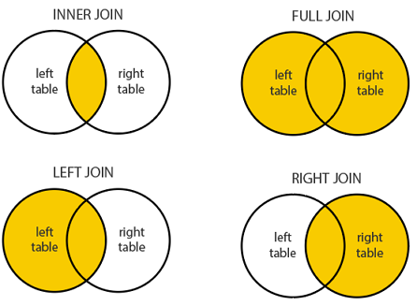
Joins
A join combines rows from two or more tables by merging them through a common column
INNER JOIN
Returns records that have matching values in both tables
FULL JOIN
Returns all records when there is a match in left or right table records
LEFT JOIN
Returns all records from left table, and any that match with the right table
RIGHT JOIN
Returns all records from right table, and any that match with the left table
Notes:
DANA
Example: If there is a table called “Orders” that describes information about orders placed in a store, and another table called “Customers” that contains customer information, and they both contain Customer ID columns, you can join the two tables by the Customer ID column. You can also select other data to display from either table, such as customer names and order dates.

Slide 18
Syntax for Joins
SELECT Fname, Lname, Salary, Gender,Dept
FROM tblLearner
INNER/LEFT/RIGHT JOIN tblDept
ON tblLearner.deptID=tblDept.ID;
Notes:
DANA
Flip screen
Merging rows from Orders with rows from Customers. Pass to Winnie after presenting.

Slide 19
Transactions
Create Procedure spHardWorks
As
Begin
Begin try
Begin transaction
Update tblLearner set Salary = ‘1000000’
Where ID = 1
Update tblLearner set Salary = ‘1M’
Where Lname like ‘[H%]’
Update tblLearner set Salary = ‘1M’
Where Fname like ‘[S%]’ and GenderID = 1
Commit Transaction
End Try
Begin Catch
Rollback Transaction
Print ‘Transaction Rolled Back’
End Catch
End
Transactions are a group of tasks performed as a single execution
The following commands are used to control transactions:
BEGIN - Indicates start point of transaction
SET - Places name on transaction
COMMIT - To save the changes
ROLLBACK - Reverses changes in case of an error; failsafe
SAVEPOINT - Creates points within the transaction to roll back to
RELEASE SAVEPOINT - Remove a savepoint
Notes:
DANA
Flip screen
Pose question to audience about code block. Stored procedure is group of T-SQL(Transit SQL statements. IF you have a situation, where you write the same query over and over again, you can save that specific query as a stored procedure and call it just by it’s name.
Transaction is one or more changes to the database. There can be multiple changes under one transaction.
Catch and End block.

Slide 20
Thank you for your time,
hope this helps!

